Slide 1

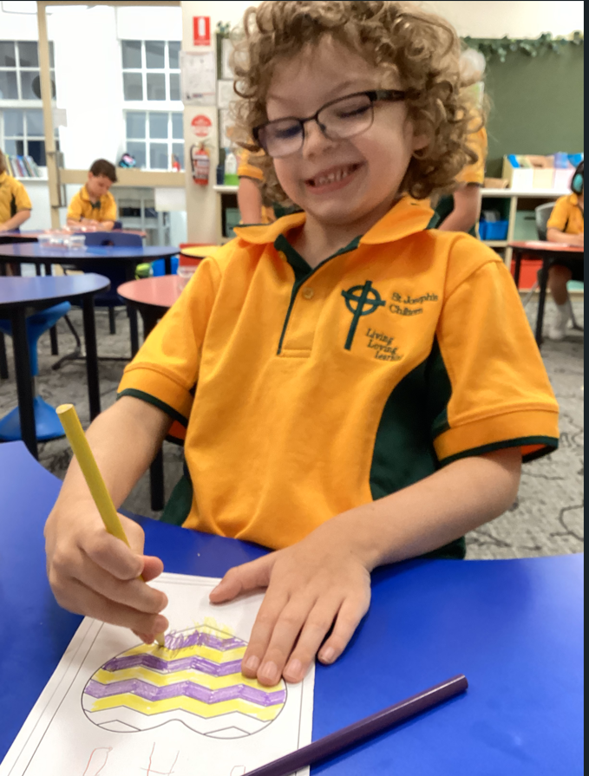
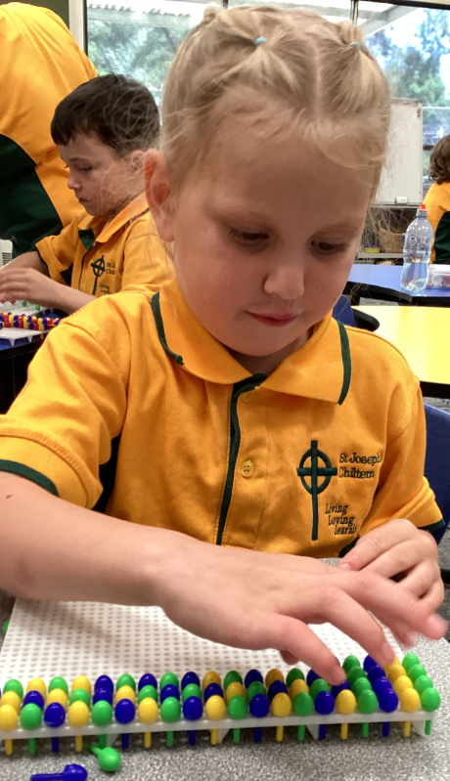

St Joseph’s Chiltern is a Child Safe school. We value, respect and empower all our students to be safe.
Newsletter Term 1- Week 2- February 7th 2025
Dear Parents & Carers,
It has been a wonderful welcome to St Joseph's and I have enjoyed meeting everyone. I have been in all the classes and spent time with the children and I look forward to getting to know you all over the coming weeks. We have had a great start to the school year and as I walk through our classrooms your children are happy and calm in their classroom environments. Lockyer and Maggie have had a wonderful start to their first school year and we look forward to watching them grow and learn in a wonderful supportive environment. We welcome Frances Ardern in Grade 5&6, Stephanie Zahra as our Science and Performing Arts specialist on Tuesdays and Mental Health in Schools Leader on Wednesdays and Thursdays. We also welcome Miv Lewis who has joined our staff to help support the children in the junior room.
Communication is a very important part of our job. My door is always open if you would like to discuss anything with me. A phone call or email is also a good form of communication. All teaching staff can be contacted by the following emails if needed during work hours, or via SIMON Everywhere app. Please also keep an eye on our school facebook page for reminders and celebrations.
edickinson@sjchiltern.catholic.edu.au
khill@sjchiltern.catholic.edu.au
lellis@sjchiltern.catholic.edu.au
fardern@sjchiltern.catholic.edu.au
szahra@sjchiltern.catholic.edu.au
Opening School Mass
Our Opening School Mass will be held in the church at 12pmTuesday the 18th of February. It would be great to see as many families as possible to help us to celebrate the beginning of the school year.
Jenny
Thank you
Jenny
Lord Jesus, we wait in joyful hope for you.
Come into our hearts
so that when the time comes we will be prepared to join you in everlasting joy.
Amen

Slide 2

St Joseph’s Chiltern is a Child Safe school.
We value, respect and empower all students to be safe.
Swimming Program starting on MONDAY​
Our swimming program is starting on Monday at the pool. There are a few important changes to our program this year. There will be two swimming groups going to the pool. The first group will be the junior group (F/1/2) and they will be bused down to the pool at 12:45pm for a 1 o'clock lesson. They will be bused back to school at 2pm. The second group which will be the 3-6 group​ they will be bused down to the pool at 2pm for their lesson. This group however will need to be picked up from the Chiltern pool by 3:15pm. If you want them to walk home from the pool or ride their bikes please let their classroom teacher know in writing or by email by Monday please.
All children will be required to wear sunscreen and a rashy or suntop as indicated on PAM/SIMON Everywhere.
Assemblies on Fridays
Each Friday we will have a quick assembly to celebrate the success of the children. It will be held promptly at 9am in the Grade 5/6 classroom. Everyone is most welcome to come along.
Canteen
At this stage we are still working on the arrangements for canteen in 2025. So I will let you know in the next week or so what is happening with this.
Information Session
Our information session will be held at school on Tuesday the 25th of February at 5:30pm. The session will allow teachers to explain how their classrooms will run throughout the day and other important information that you will need to know. If you are unable to attend on that evening a parent information handbook will also be sent home with all the information you will need to know.
Sports Days
Sports days will be as follows.
F-2 Wednesday & Thursday
3-4 Monday & Thursday
5-6 Monday & Thursday
SCHOOL CLOSURE DAYS 2025: 'Magnify' Staff Professional Learning Days
TERM 1: January 28th and 29th
TERM 2: April 22nd to 24th and June 18th
TERM 3: August 13th
TERM 4: November 3rd, December 5th,18th and 19th
Have a great week.
Regards
Libby
​
a
Attendence
Parish Mass Times
6:00PM Saturday
12pm Wednesday

Slide 3
St Joseph’s Chiltern is a Child Safe school.
We value, respect and empower all students to be safe.
Our School Uniform
The St Joseph's uniform is based on the school colours of green and gold. The School approved full uniform is available from Chiltern Post Office.
Summer
· Bottle green shorts or green skort or green and white checked dress
· Short sleeve gold polo shirt with bottle green and gold stripes collar
· Black shoes; white socks
Bottle green school hat (logo)
Winter
· Green pants
· Gold polo shirt (long or short sleeve) with bottle green and gold stripes collar
· Bottle green bomber jacket (logo)
Black shoes; white or grey socks
Sport
· Green shorts or green skort or green tracksuit pants
· Gold polo shirt (long or short sleeve) with bottle green and gold stripes collar
Black shoes; white socks
Sun Smart
School hats are worn in terms 1 and 4. Children without a hat are asked to play under the veranda.
Accessories
No jewellery, colourful hair accessories, make-up or nail polish are to be worn at school.
All clothing is to be clearly labelled with your child’s name.
INTERESTED IN BEING PART OF OUR PARENTS & FRIENDS?
WOULD YOU LIKE TO BE PART OF THE NEXT SCHOOL ADVISORY COUNCIL IN 2025?
Are you keen to take an active role in your child's school? Time commitment is limited to once or twice a term. Please see me if you are interested. Your contribution is always valued.
a

Slide 4
St Joseph’s Chiltern is a Child Safe school. We value, respect and empower all our students to be safe.
COMMUNITY CALENDAR
Monday 10th of February | Swimming starts and for the whole week
Wednesdays 12th/19th/26th of February | Foundations rest days
Tuesday 18th of February | Opening School Mass 12pm
Tuesday 25th February | Information Evening at 5:30pm
Tuesday 4th March | Shrove Tuesday
Wednesday 5th March | Ash Wednesday 12pm Mass Foundations students full time.
Monday 10th March | Labour Day Public Holiday
Wednesday 12th | NAPLAN Testing begins for Grades 3 & 5
Thursday 20th March | Family Sports Night
Monday 24th March | Italian Excursion to Rutherglen
Friday 4th April | Last day of Term 1 staudents finish at 2:30pm
Friday 18th April | Good Friday
Sunday April 20th | Easter Sunday
Monday April 21st | Easter Monday
Tuesday April 22nd – Thursday April 24th | Staff Professional Learning Days NO STUDENTS
Friday April 25th | ANZAC Day Public Holiday
Monday April 28th | Students commence Term 2
Please check SIMON/ PAM for further details on early 2025 dates
a

Slide 5

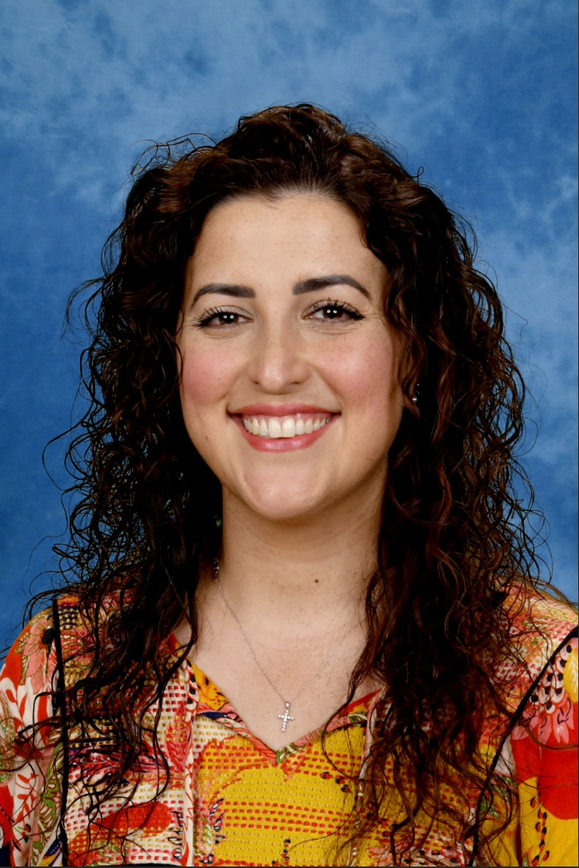
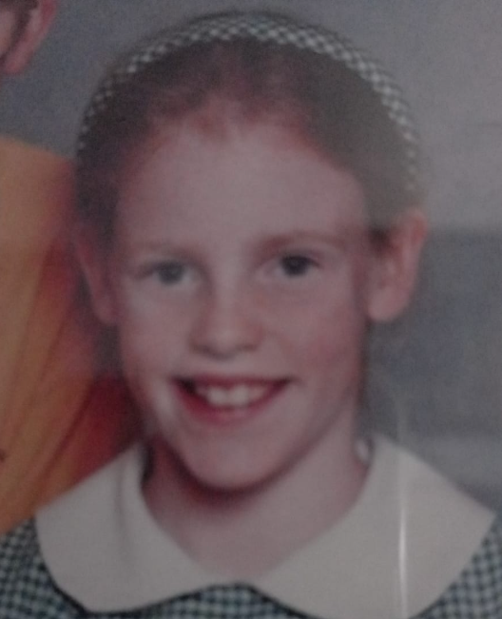
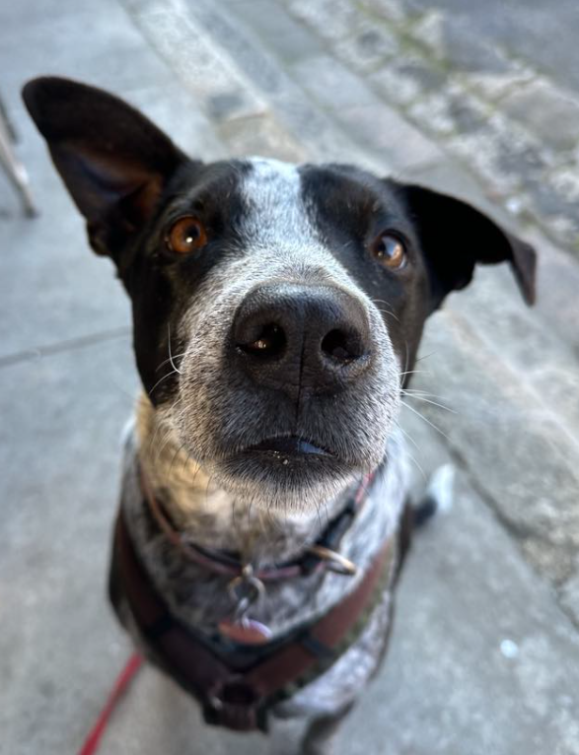
St Joseph’s Chiltern is a Child Safe school.
We value, respect and empower all students to be safe.
​
Introducing Ms Stephanie Zahra
A big, warm ‘Hello’ to the St Joseph’s Primary School Community!
My name is Stephanie Zahra, and I am thrilled to be joining the St Joseph’s family, working in my roles as our Mental Health and Wellbeing Leader and as a Performing Arts and Science Specialist teacher.
My role as a Mental Health and Wellbeing Leader is to build the capability of the whole school with regard to Mental Health and Wellbeing (identification, promotion and prevention); provide support to staff to better support student Mental Health needs, establish clear pathways for referral for students requiring assessment and intervention, and monitor and evaluate student progress.
This role is different to a ‘student support services officer’ or ‘psychologist’. It is a role which helps to ‘get a child the care they need’, once a teacher, staff member or parent identifies a concern in the classroom. I will work with allied health professionals, school wellbeing teams and families to engage appropriate mental health support for our students.
I am also hoping to use my role as a specialist Performing Arts and Science teacher to promote wellbeing and a love for learning in our school. I am really enjoying getting to know your beautiful children and supporting our school community.
Please feel free to come and say hello!
Introducing Ms Frances Ardern
A great big hello to you all!
I'm so excited to be part of the St Joseph's School community once again. Once again? Yep! Many, many (many) years ago, I was a student here. There school has changed quite a bit since I finished in 2000 - the classrooms are updated, iPads exist, and there's TVs on the wall, not on wheels!
I've been a teacher for 8 years, and in this time, I've taught in Melbourne, Darwin, and the Tiwi Islands. It's a delight to be back home, living in the region that I love most. When I'm not teaching, I love reading, painting, cooking, and spending time with my family and friends. I have a dog called Moe, who loves eating blueberries and peanut butter. I'm looking forward to meeting you all, and being part of the St. Joseph's School community.
a

Slide 6
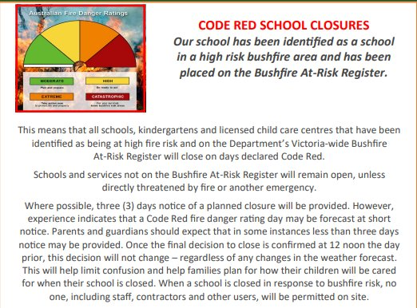

.
a
Magnify
As you know from last year and the new banners on our front gate, Magnify Sandhurst is a new program that has been introduced into our schools this year. Our staff have been working very hard learning and planning over the break to ensure that the practises they are using in the classroom to teach your children are evidence based and effective. So you will be hearing words such as MultiLit and MacLit which are literacy programs. You will be hearing about Ochre which is a resource we are using to teach English and Maths that has structured, knowledge rich curriculum. We want you come on the learning journey with us throughout the year so we will continually share our learnings with you with the aim to improve the outcomes for your children. What an exciting year we have ahead!

Slide 7
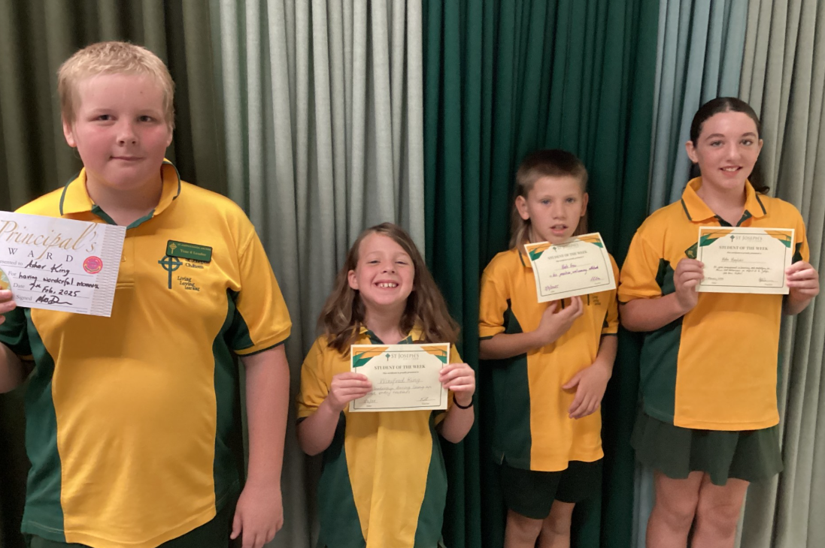
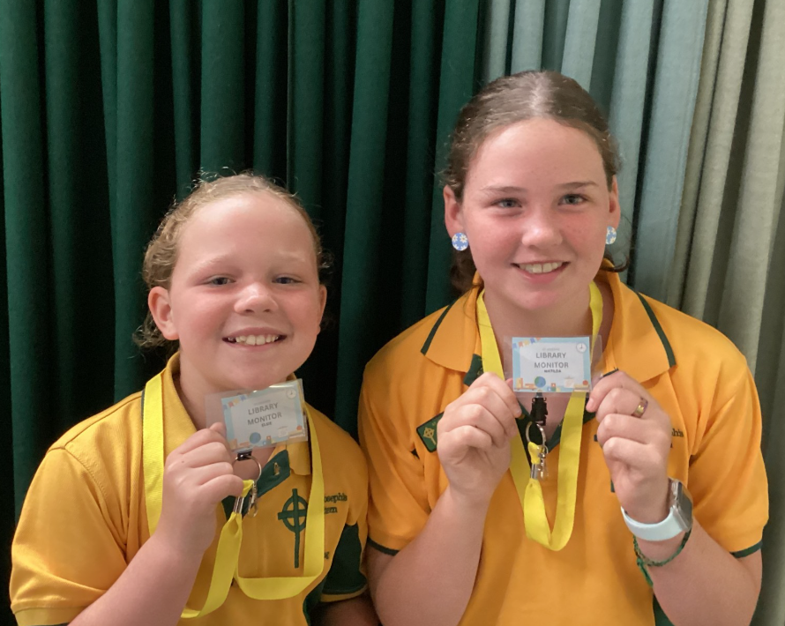
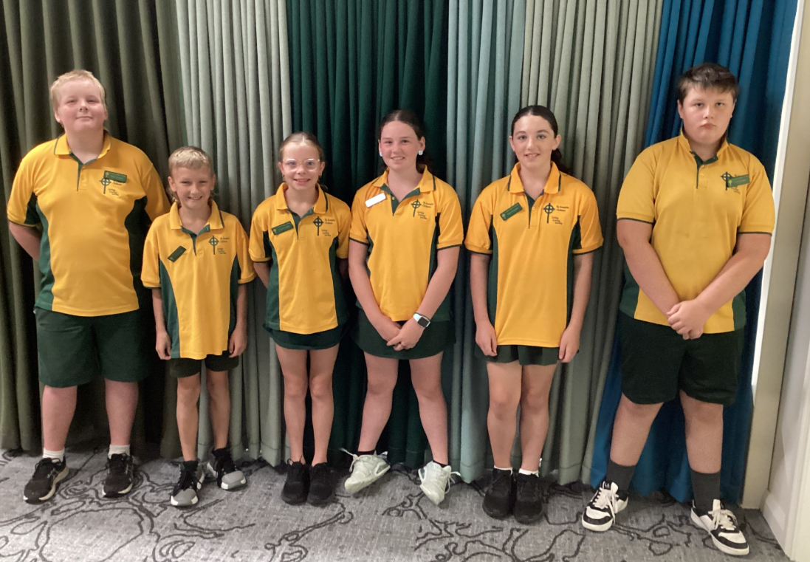
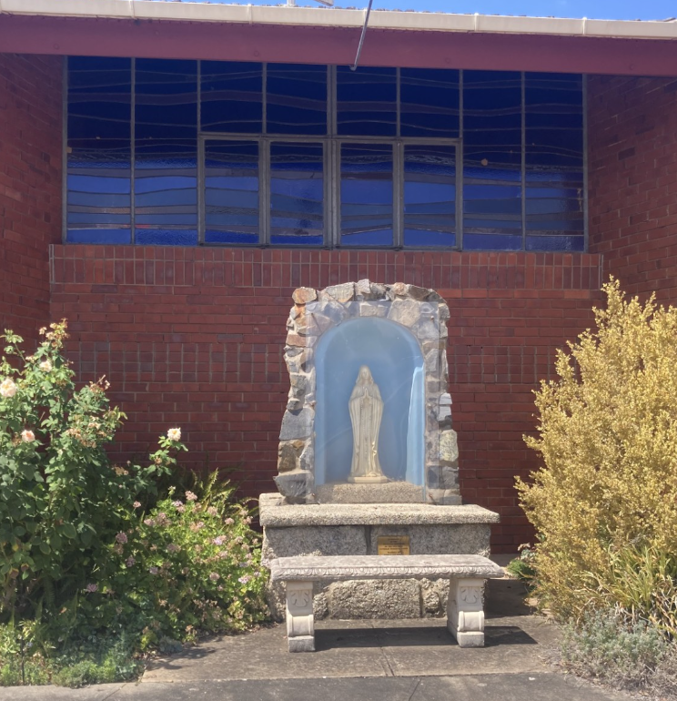

STUDENT AWARDS
  Congratulations to this week's Award Winners
Term 1 Week 2
Foundation /Year 1/ 2 KH: Winifred King
Year 3/4/ LE: Nate Frew
Year 5/6 FA: Mollie Magelakis
Principal’s Award: Asher King
Congratulations to our Grade 6 New Library Monitors
Leaders receiving their badges.
Parish Mass Times
6:00PM Saturday
12pm Wednesday
HAPPY BIRTHDAY! ​
​Sharon
Debbie
Mollie
Maggie

Slide 8



